Slide 1
BUZZ WIRE GAME

Slide 2
DIY PROJECT IITKGP
BUZZ WIRE GAME
By ---
Sasmit Kolhe 20MT10054
Rithick Prabakar 20ME10071
Shubham Kumar 20IM10037
Kshitija Bobade 20GG20016

Slide 3
ABOUT THE PROJECT
Project Name : Buzz Wire Game
Project By : Sasmit Kolhe
Rithick Prabakar
Shubham Kumar
Kshitija Bobade
Guidance : Mr. Bharat Naik
Prof. Arkopal Goswami
Prof. Gouri Gargate
Prof. Mamoni Banerjee

Slide 5
Buzz wire is a steady hand game made from the background of coding and Arduino hardware. It has a wire that is bent into a curvilinear path to make the game challenging and competitive. The player's main objective is to bring the metal hoop from one to the other end without touching the wire. Whenever the player touches the wire, the LED will glow, and the buzzer will buzz. There is a limit set for the number of fails, and if the player crosses the threshold, the game ends. Further thing, here, is an LED counter which displays the number of fails.

Slide 6
PROJECT AGENDA
Week 1
Project selection
Working on required components
Week 2
Project agenda determination
Task distribution
Week 3
Model Making
Coding
Week 4
Execution
Design
Circuit generation
Understanding and studying about the project
Working on errors and their removal

Slide 7
TASK DISTRIBUTION
Shubham
Model making
Rithick
Arduino programming
Sasmit
Project selection
Kshitija
Model video
Circuit studying and explanation
Arduino Programming
Design
Explanation
Agenda and co-ordination
Working on errors

Slide 8
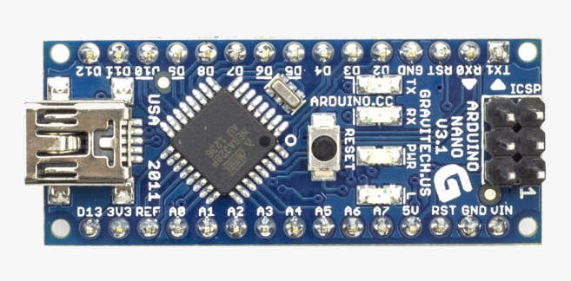
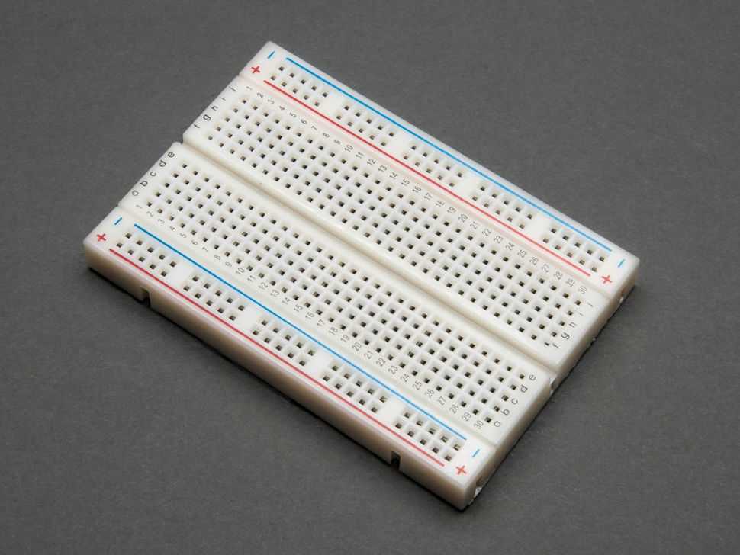
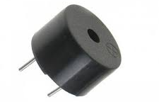
REQUIRED COMPONENTS
Arduino Nano
Breadboard
Buzzer

Slide 9
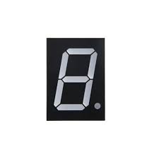
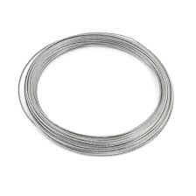
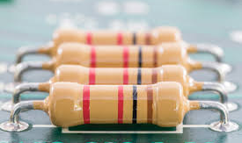
REQUIRED COMPONENTS
7 Segment LED
Resistors
Steel Wire

Slide 10
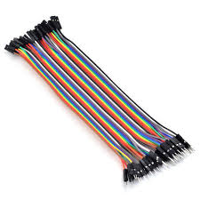
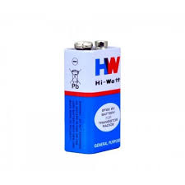
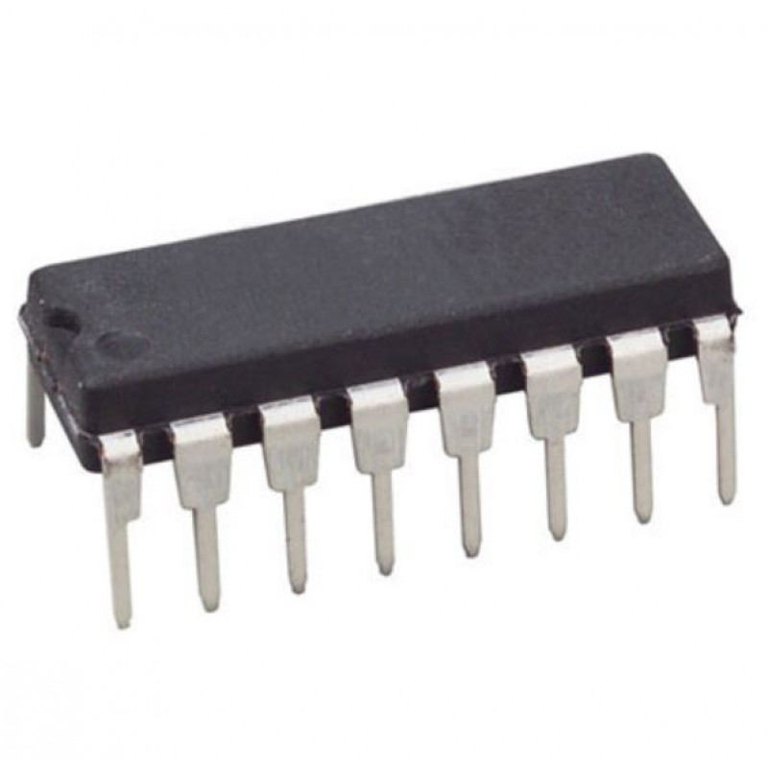
REQUIRED COMPONENTS
Jumper Wire
9V Battery
74HC595

Slide 11
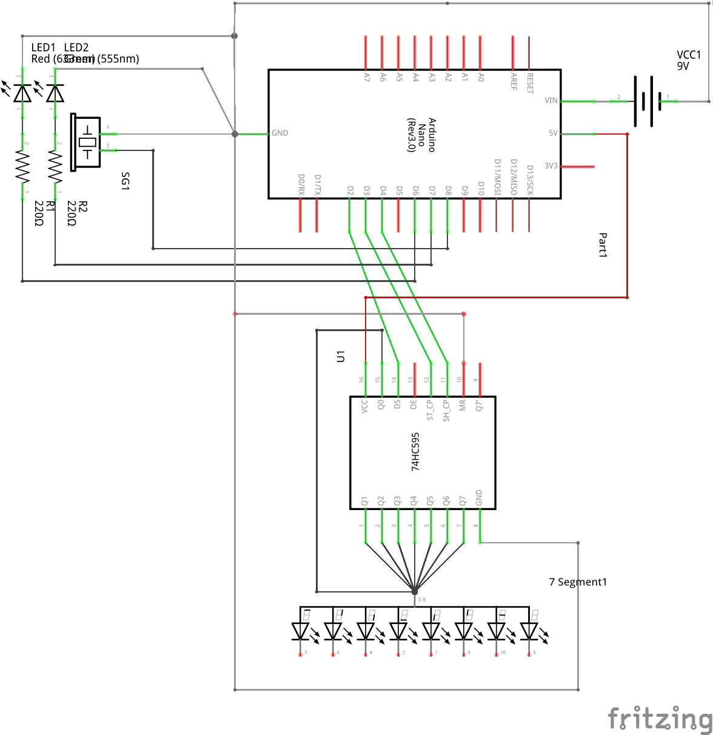
Circuit Diagram

Slide 12
Circuit Explanation
Arduino Nano, 7 segment LED Display, LED Bulb, Buzzer, 74HC595 these are the major components of circuit. In this circuit as our loop touches the zigzag wire circuit gets completed. The Touch of wire is acting as an Input and with the help of code for Arduino board, Digital pins are sending signal to Output Buzzer and LED bulb to turn them ON and also sends Signal to 7 segment LED so that it vary according to the code.
74HC595 is required to connect 7 segment LED display with Arduino board to work display according to code.

Slide 13
CODING
int latchPin = 3; // ST_CP [RCK] on 74HC595
int clockPin = 4; // SH_CP [SCK] on 74HC595
int dataPin = 2; // DS [S1] on 74HC595
const int wire = 10; // The pin of the wire
const int led = 6; // Pin to be connected to the LED
const int buzzer = 8; // The pin of buzzer
const int fail_threshold = 9; // The Threshold of failing
byte seg_digits[10] = // The function which contains all the segment digits to display each number
{
B00000011, // = 0
B10011111, // = 1
B00100101, // = 2
B00001101, // = 3
B10011001, // = 4
B01001001, // = 5

Slide 14
B01000001, // = 6
B00011111, // = 7
B00000001, // = 8
B00001001, // = 9
};
enum Status // To assign a constant to a name variable
{
STOP = 0, // Stop is assingned number 0
GO = 1 // Go is assigned number 1
};
void displayDigit(int x) // Function to display the number on the LED screen
{
digitalWrite(latchPin, LOW);
shiftOut(dataPin, clockPin, LSBFIRST, seg_digits[x]);
digitalWrite(latchPin, HIGH);
}
void displayInitialSetup() // The function consisting of display's initial setup
{
pinMode(latchPin, OUTPUT);
pinMode(dataPin, OUTPUT);

Slide 15
pinMode(clockPin, OUTPUT);
displayDigit(0);
}
void beep() // Function to make the buzzer beep
{
for(int i=0; i<2; i++)
{
digitalWrite(buzzer, HIGH);
delay(50);
digitalWrite(buzzer, LOW);
delay(50);
}
}
void failAlarm() // Function to indicate the touching of wire(Failing)
{
digitalWrite(led, HIGH);
beep();
delay(150);
digitalWrite(led, LOW);
digitalWrite(buzzer, LOW);
delay(500);
}

Slide 16
void gameInitialSetup() // Initializing game setup
{
pinMode(led, OUTPUT);
pinMode(buzzer, OUTPUT);
pinMode(wire, HIGH);
digitalWrite(led,LOW);
digitalWrite(buzzer,LOW);
digitalWrite(wire, LOW);
}
void setup() {
Serial.begin(9600);
displayInitialSetup();
gameInitialSetup();
}
Status stat = GO; // Setting initial conditions
int failCounter = 0; // The variable to count the number of fails
void loop() {

Slide 17
while (failCounter > fail_threshold) // To check whether the player has crossed the failing limit
{
gameover();
}
switch (stat) // The loop of the game till the player fails
{
case GO: // Case of not touching the wire(Non fail)
digitalWrite(led, LOW);
digitalWrite(buzzer, LOW);
if (digitalRead(wire) == HIGH)
{
stat = STOP;
}
break;
case STOP: // Case when the player touches the wire(Fails)
failCounter++;
if (failCounter > fail_threshold)
break;
displayDigit(failCounter);
Serial.println(failCounter);

Slide 18
failAlarm();
stat = GO;
break;
}
}
void gameover() // To make a significant difference from beeping when the game is over
{
for (int i=0; i<2; i++)
{
digitalWrite(led,HIGH);
digitalWrite(buzzer, HIGH);
delay(5);
digitalWrite(buzzer, LOW);
digitalWrite(led,LOW);
delay(50);
}
}

Slide 19

Code in Arduino
Code explanation
In the first part of the code we have defined integer variables based on the pins we have to attach.
Then functions are made for the following things :
Binary function to display digits on LED
Game and display initializing functions
Each fails alarm and Game over alarm
While and Switch loops are here used to determine the contact of the hoop and the wire

Slide 20
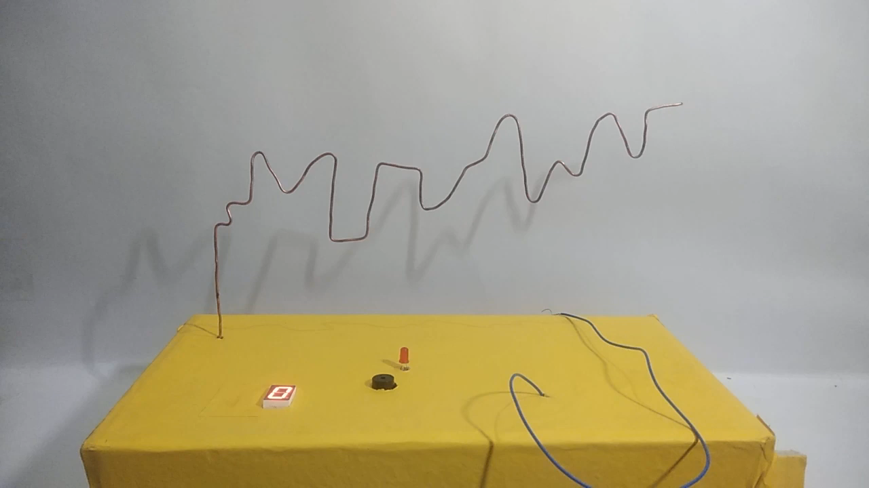
Working Model’s Video

Slide 21
REAL TIME
APPLICATIONS
This game can be used in medical field by psychologists to test the overall concentration and consistency of a person
It improves hand and eye co-ordination
It’s fun!!

Slide 22
Acknowledgement
We are extremely grateful to all who helped us for making this project.
Thank you so much Mr. Bharat Naik for your support and help.
Special thanks to Prof. Arkopal Goswami , Prof. Gouri Gargate , Prof. Mamoni Banerjee for their guidance for completing this project .
And also thanks to all TAs for their guidance from time to time.

